Slide 1
Study Notion portal
Submitted by:
Manoj Kumar
Manibhushan Kumar
Ramchandra Nath Siddh
Aditya Rajendra Narnaware
Under the Guidance of:
Mr. Deepak Painuli
Assistant professor

Slide 2
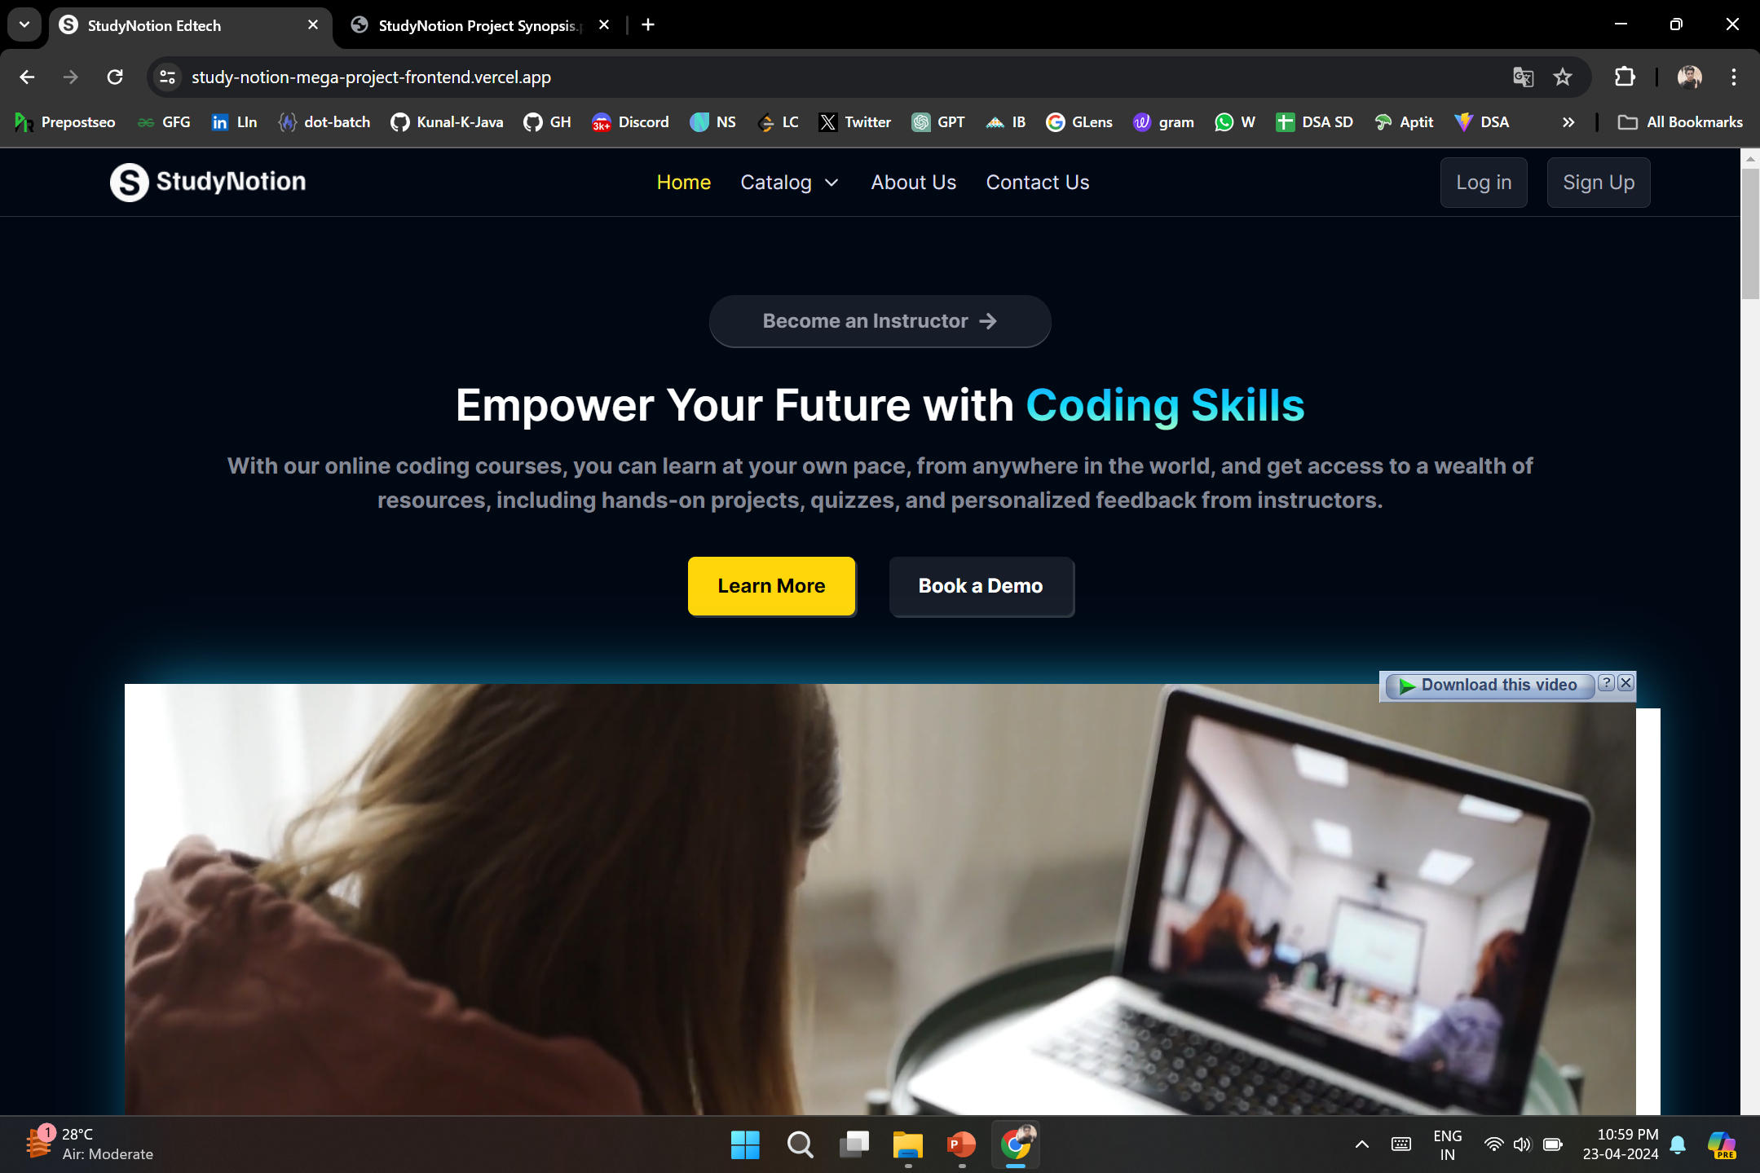
Ui Design of Projects

Slide 3
INTRODUCTION
StudyNotion is a fully functional EdTech platform that enables users to create, consume, and rate educational content.
The platform is built using the MERN stack, which includes ReactJS, NodeJS, MongoDB, and ExpressJS. StudyNotion aims to provide a seamless and interactive learning experience for students, making education more accessible and engaging.
Additionally, the platform serves as a platform for instructors to showcase their expertise and connect with learners across the globe.

Slide 4
System Architecture
The StudyNotion EdTech platform consists of three main components:
the front-end,
the back-end,
and the database.
The platform follows a client-server architecture, with the front-end serving as the client and the back-end and database serving as the server.

Slide 5
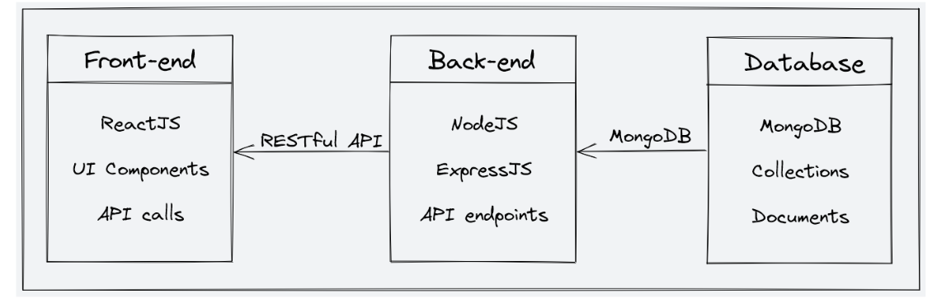
Project Pipeline
Below is a high-level diagram that illustrates the architecture of the StudyNotion EdTech platform

Slide 6
Front-End Part
The front-end of the platform is built using ReactJS, which allows for the creation of dynamic and responsive user interfaces, crucial for providing an engaging learning experience to students. The front-end communicates with the back-end using RESTful API calls.
For Students:
Homepage, Course List, Wishlist, Cart Checkout Course Content, User, DetailsUser, Edit Details
Front-end Tools and Libraries
To build the front-end, we use frameworks and libraries such as ReactJS, CSS, and Tailwind for styling, and Redux for state management.

Slide 7
Back-End part
The back-end of the platform is built using NodeJS and ExpressJS, providing APIs for the front-end to consume. These APIs include functionalities such as user authentication, course creation, and course consumption. The back-end also handles the logic for processing and storing the course content and user data.
Back-end Features
User Authentication and Authorization: Students and instructors can sign up and log in to the platform using their email addresses and passwords. The platform also supports OTP (One-Time Password) verification and forgot password functionality for added security.
Course Management, Payment Integratio, Cloud-based Media Management, Markdown Formatting.
Back-end Frameworks, Libraries, and Tools
The back-end of StudyNotion uses various frameworks, libraries, and tools to ensure its functionality and performance, including:
Node.js, Express.js, MongoDBJWT (JSON Web Tokens), Bcrypt, Mongoose

Slide 8
Database part
Data Models and Database Schema
The back-end of StudyNotion uses several data models and database schemas to manage data, including:
Student Schema, Instructor Schema, Course Schema
The database for the platform is built using MongoDB, a NoSQL database that provides a flexible and scalable data storage solution.
MongoDB allows for the storage of unstructured and semi-structured data.
The database stores the course content, user data, and other relevant information related to the platform.

Slide 9
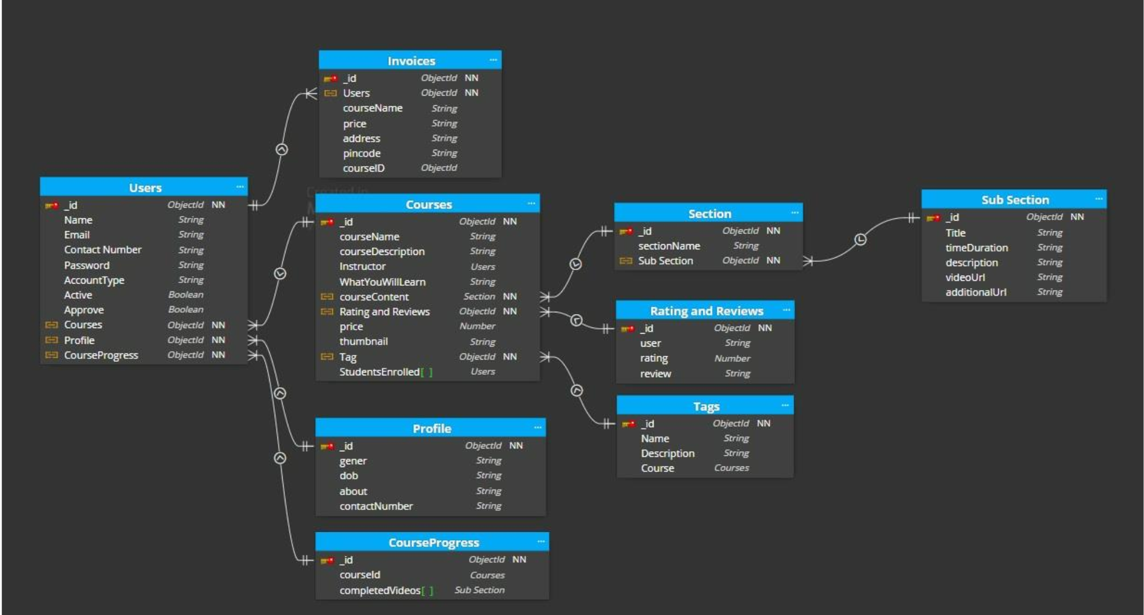
Api design

Slide 10
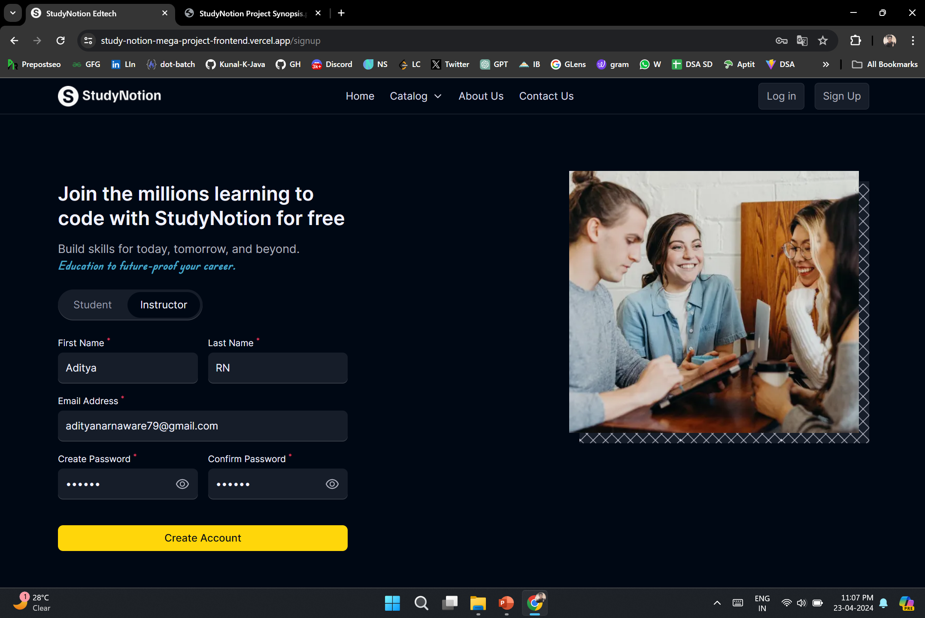

Slide 11
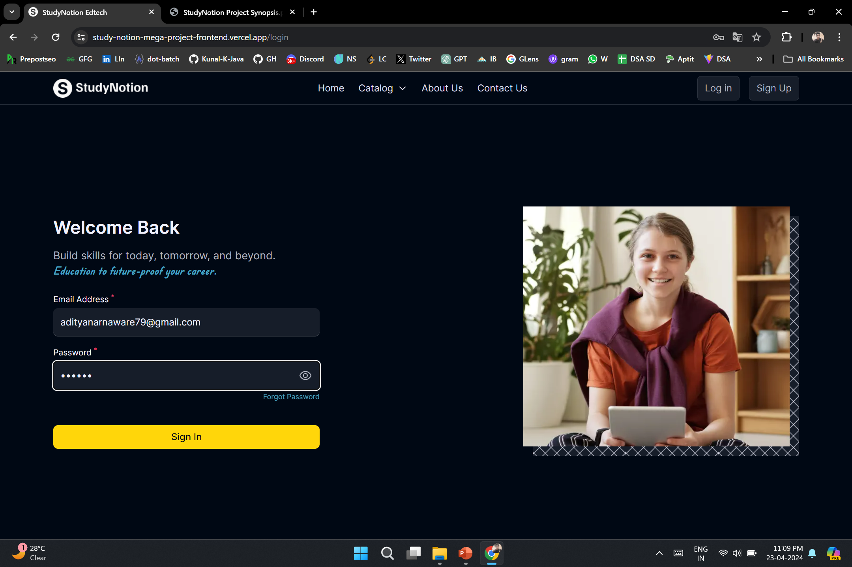

Slide 12
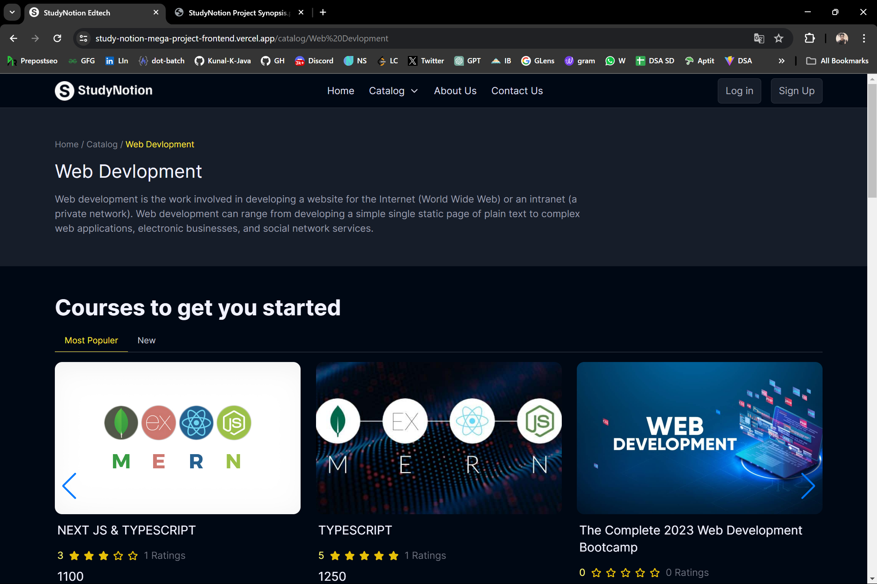

Slide 13
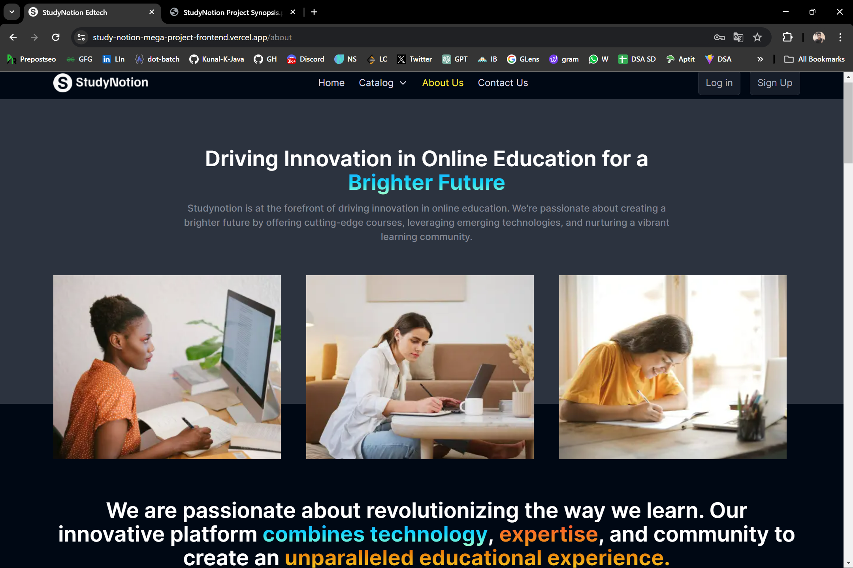

Slide 14
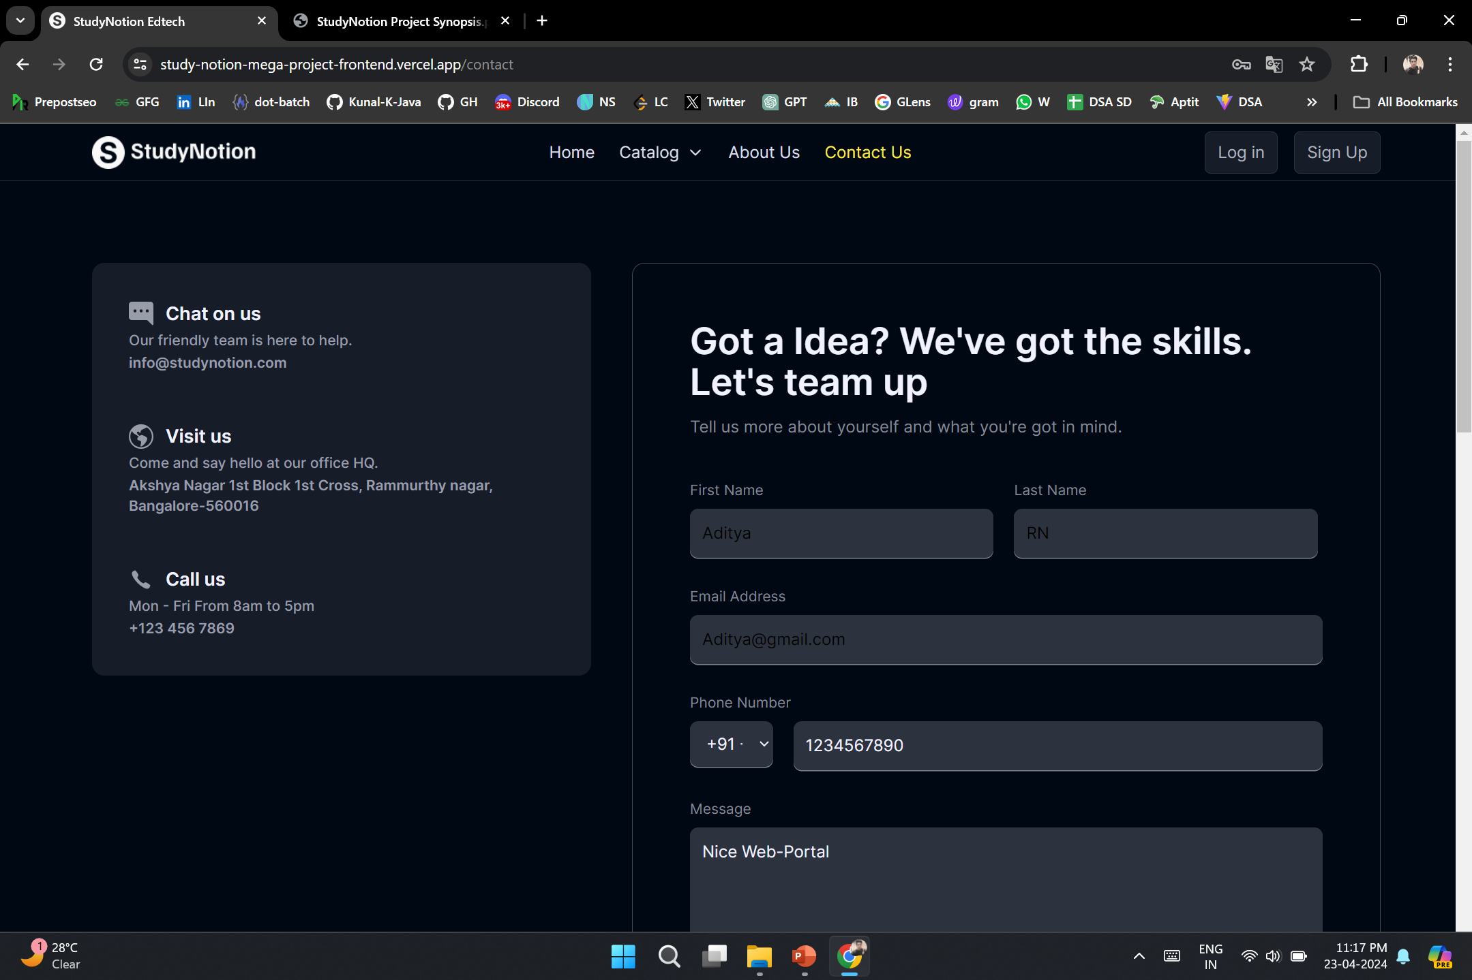

Slide 15
THANK YOU
https://study-notion-mega-project-frontend.vercel.app/

